Slide 1
Final project
Proposal
Name
Department Course Number Section Time Location
DATE
Chenxi Xu

Slide 2
Continue with my midterm…

Slide 3
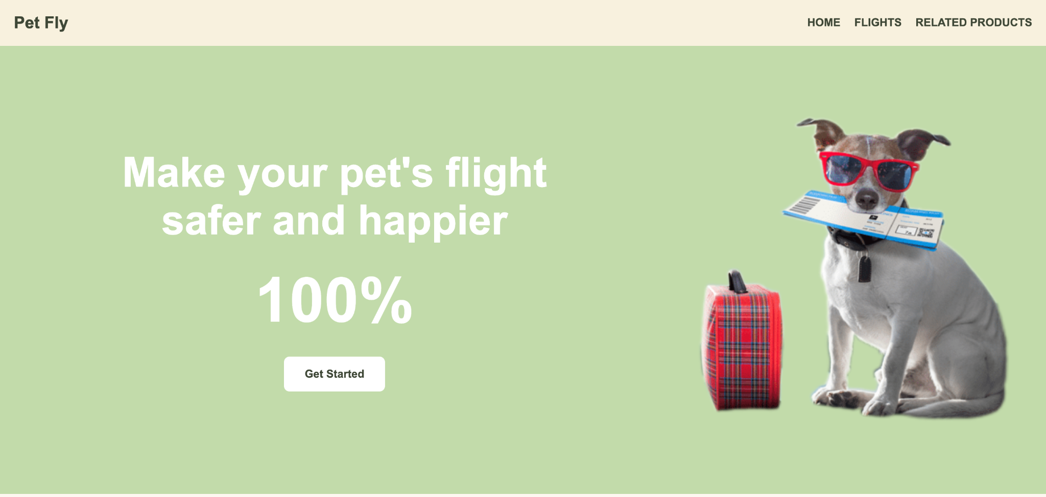
Add hover effect, and make it more refined
Make it appear with a typing effect and add animation
Redesign the button

Slide 4
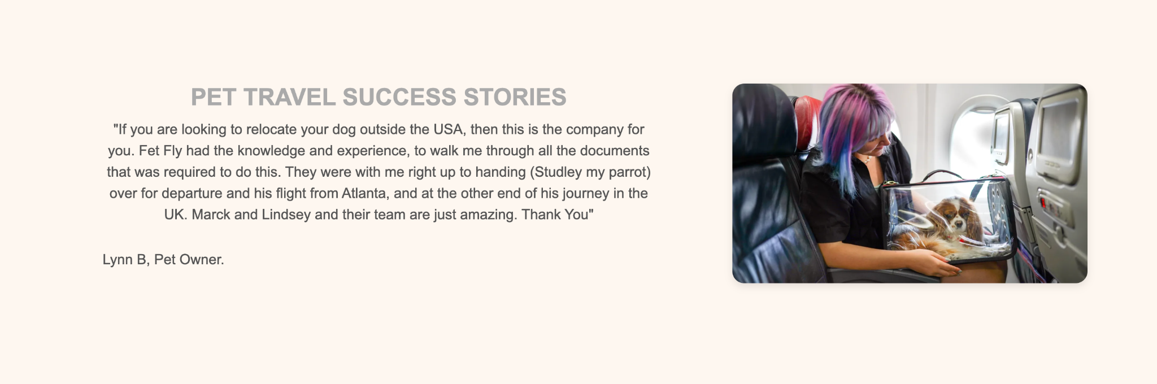
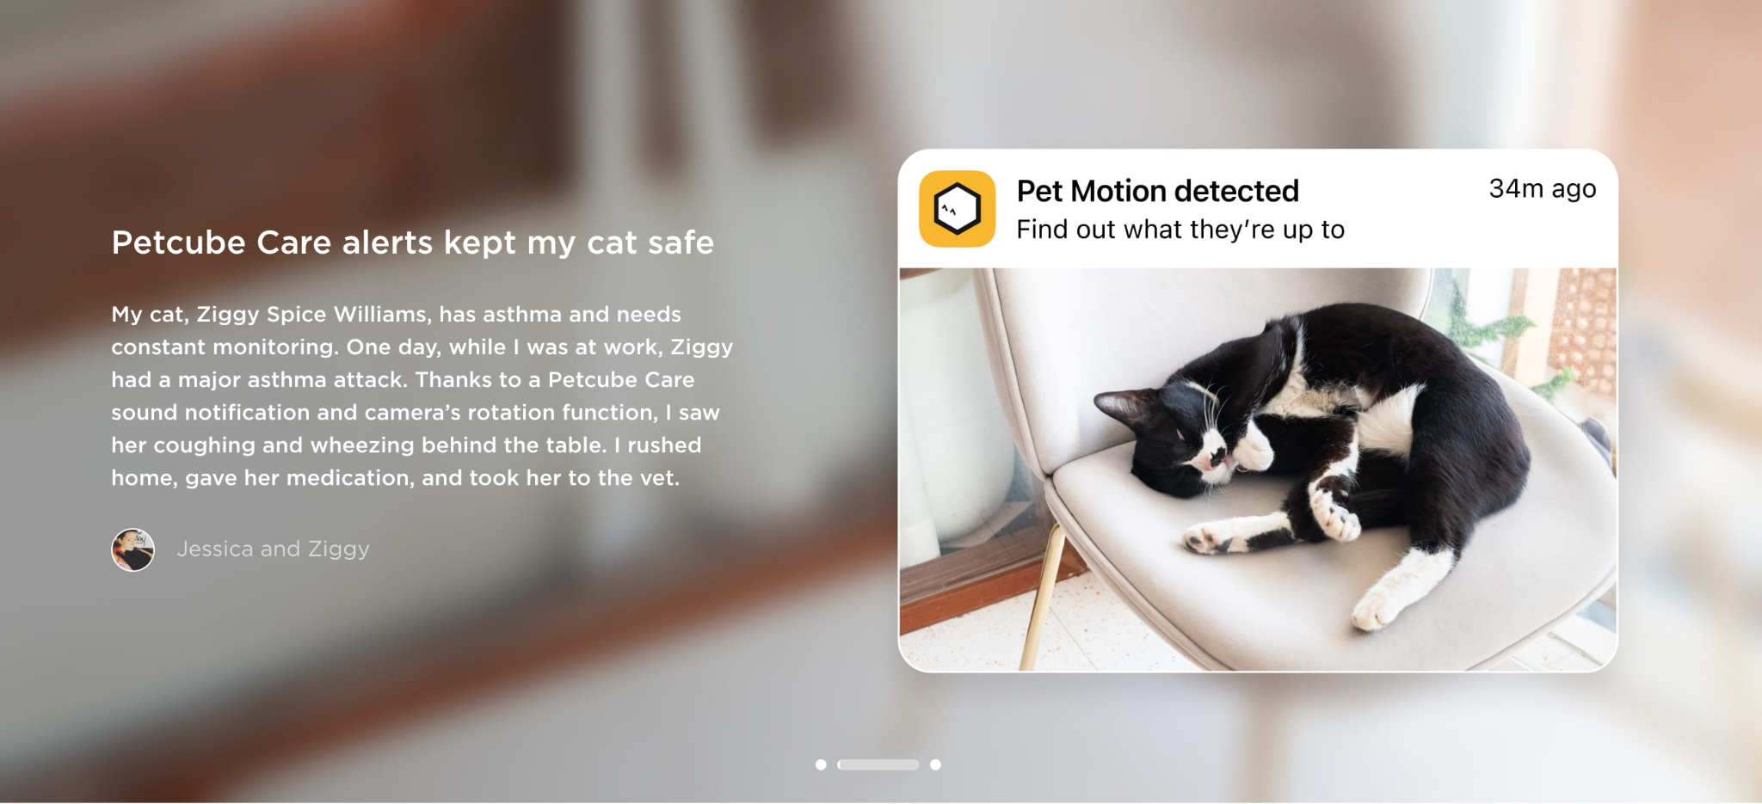
Design it as a carousel and add more examples

Slide 5
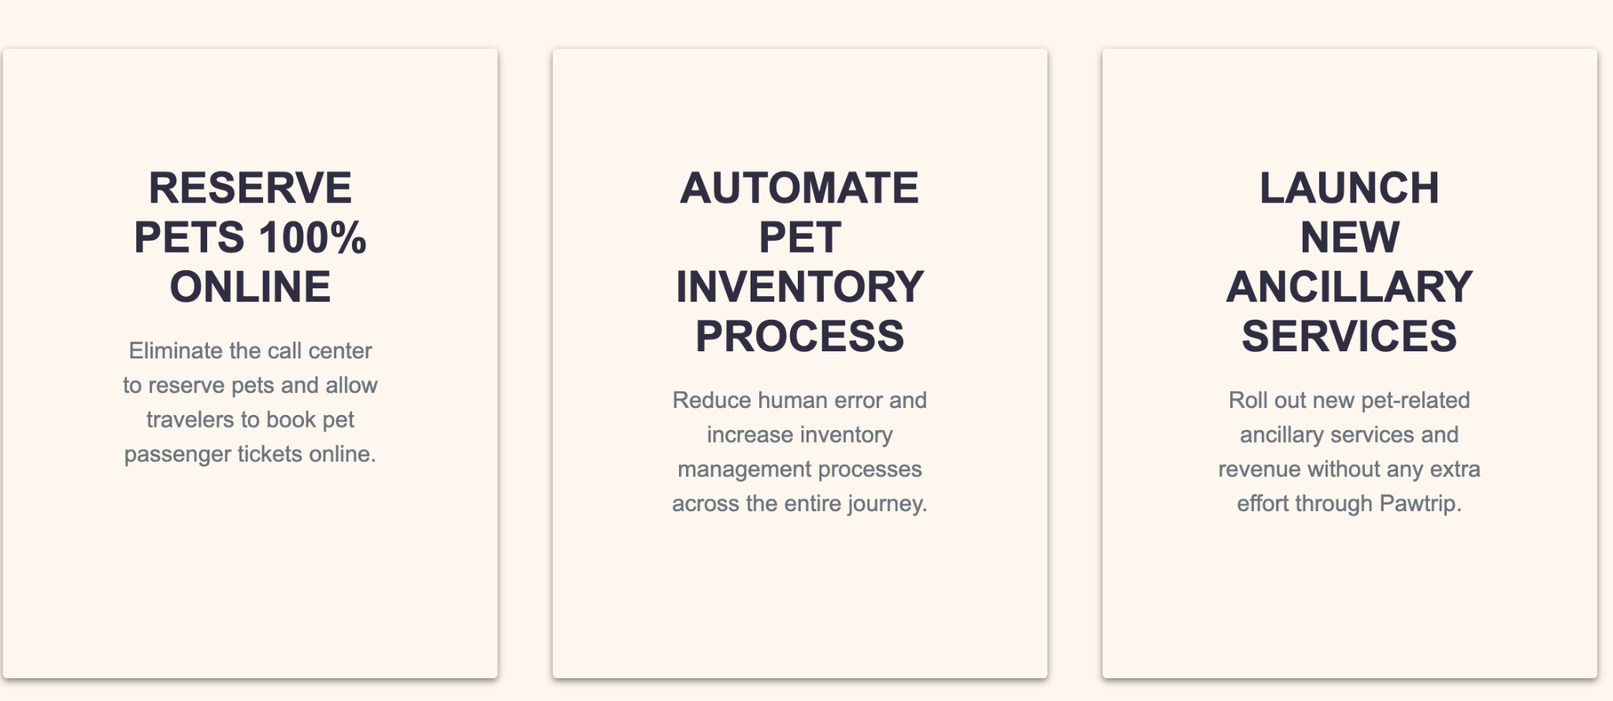
Add Add hover effects to highlight the words.

Slide 6
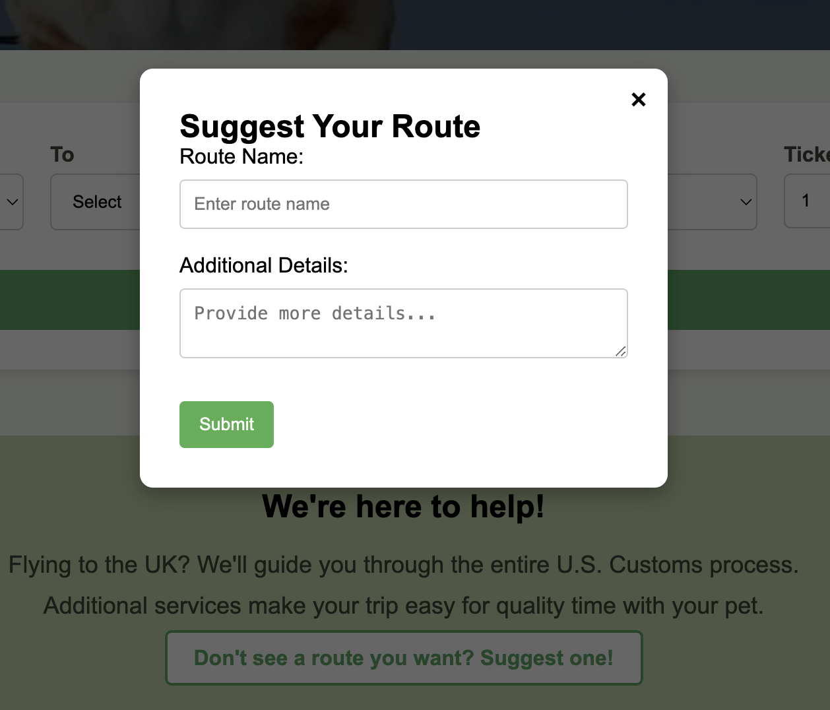
Add user input, and when the submit button is clicked, it changes to "Thank you for submitting

Slide 7
To-do list:
Navigation bar
Add storage
buttons
Add geolocation
Carousel
User input
Add hover effects
Add animation

Slide 8
Thank You!!!
Name
Department Course Number Section Time Location
DATE

